Slide 1
Securing and increasing productivity of BYOD classrooms at schools​
PIP104 University Project-II
Review-1
Batch Number: 99
Roll Number | Student Name
20211CSE0168 | B Jaswanth Reddy
20211CSE0477 | S Kavya Sree
20211CSE0472 | Gopi Priya G
20211CSE0473 | O Nagendra babu
Under the Supervision of,
Ms. Nitya BA
Professor / Associate Professor / Assistant Professor
School of Computer Science & Engineering
Presidency University

Slide 2
Introduction
With the rise of technology in education, many schools have adopted the Bring Your Own Device (BYOD) policy to facilitate a more personalized and flexible learning environment. BYOD classrooms allow students to use their personal devices, such as laptops, tablets, and smartphones, for educational purposes. This approach enhances engagement, provides access to online learning resources, and supports a blended learning model.
This project aims to develop strategies and solutions to secure BYOD classrooms while promoting a productive learning environment. It focuses on implementing robust security measures, such as device monitoring, content filtering,to safeguard both students and school infrastructure. By increasing control over network access and curating appropriate online resources, schools can optimize the educational benefits of BYOD without compromising safety or productivity.

Slide 3
Literature Review
The implementation of Bring Your Own Device (BYOD) policies in schools has led to increased access to educational resources but also presents challenges, particularly regarding distractions from non-educational content. Research highlights several key points:
Learning Impact: BYOD enhances student engagement but can also lead to distractions that hinder learning (Gomez et al., 2015; Bennett & Matron, 2010).
Need for Website Filtering: Educators emphasize the necessity for filtering tools to block inappropriate content and maintain focus in the classroom (Wexler, 2018).
Teacher Management Tools: Effective monitoring and control mechanisms help improve student behavior and academic performance, allowing teachers to customize access based on curriculum needs (Ribble, 2015).
Cybersecurity Risks: Increased device connectivity raises cybersecurity concerns, making robust filtering systems essential for protecting student data (Alasmary et al., 2020).
Data-Driven Insights: Utilizing analytics to monitor student engagement can enhance instructional strategies and improve learning outcomes (Siemens, 2013).

Slide 4
Objectives
Providing a web application for teachers and students to interact using unique credentials .​
Equip teachers with a user-friendly dashboard to manage students' devices giving limited access to recourses and using web filtering software’s ensuring better control and supervision.​
Create a cloud environment that enables students to access educational content.​
Building custom firewall with advanced web filtering technologies that prevent student’s devices from accessing restricted content and protect against cyber threats and use monitoring software's for viewing the health of the system.​
Deploying Ai chat box for building conversational agents and help with student queries.​

Slide 5
Proposed Method/Methodology.
Developing a web application for user registration system.
Content Filtering and Application Management, URL filtering, keyword blocking, and category-based filtering.
Device Monitoring and Management.
Deploying Google cloud platform for students
Using Google Dialogflow which is a cloud-based NLU platform.

Slide 6
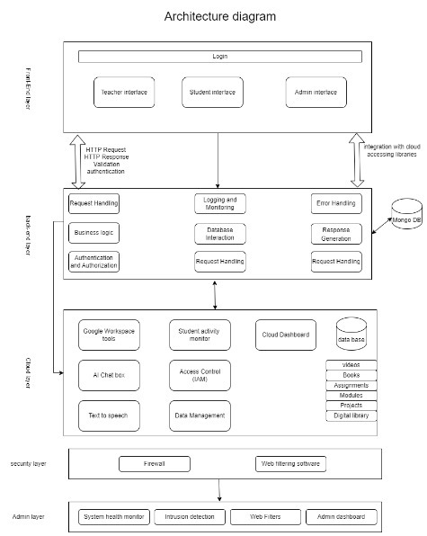
Architecture diagram

Slide 7
Timeline of Project
Tasks​ | Review 0​ | Review 1​ | Review 2​ | Review 3​ | final​
Tittle Finalizing​ | ​ | ​ | ​ | ​ | ​
Literature Survey and analysis of project statement​ | ​ | ​ | ​ | ​ | ​
Finalizing objectives and deciding methodology​ | ​ | ​ | ​ | ​ | ​
Finding existing GAPS in the project​ | ​ | ​ | ​ | ​ | ​
Referring research papers for better insight ​ | ​ | ​ | ​ | ​ | ​
Designing and developing web portal and registering users and storing in MongoDB​ | ​ | ​ | ​ | ​ | ​
Developing a cloud environment for uploading educational content and videos and Implementing access control through cloud dashboard​ | ​ | ​ | ​ | ​ | ​
Implementing firewall using (NGFWs)​ | ​ | ​ | ​ | ​ | ​
50% Implementation with live demo and report​ | ​ | ​ | ​ | ​ | ​
Developing a web page to monitor firewall for intrusion detection​ | ​ | ​ | ​ | ​ | ​
Integrating the firewall with web filtering technologies and restricting content using web filters​ | ​ | ​ | ​ | ​ | ​
Integrating cloud with Dialogflow tool for handling student queries ​ | ​ | ​ | ​ | ​ | ​
100% implementation with live demo and report (hardcopy)​ | ​ | ​ | ​ | ​ | ​
Plagiarism report on project report​ | ​ | ​ | ​ | ​ | ​
Publication of project report​ | ​ | ​ | ​ | ​ | ​
Patent on project report​ | ​ | ​ | ​ | ​ | ​

Slide 8
Expected Outcomes
This approach will ensure that BYOD classrooms are secured against both internal and external threats while maintaining a productive and focused learning environment. Through strategic network segmentation, content filtering, and device management, schools will have the necessary tools to enhance educational outcomes while mitigating risks associated with the BYOD model.

Slide 9
Conclusion
Overview of the Implementation of a Secure and Productive BYOD in Schools: A Requirement for Increased Learning and Safety When integrating network segmentation, mobile device management, content filtering, and real-time monitoring into school networks, students will be safe from threats, and the networks will produce significant results by complementing students’ responsibilities to complete their tasks. Enabling web access control and having productivity tools in addition to pushing still provides teachers control over what students can get to on the web and improving the classroom experience. Such an approach enables the institution to develop a secure, efficient, and a technological learning environment for the achievement of education objectives as well as enhancing student interest.

Slide 10
References
References of IEEE papers:​
BYOD Education by Chinecherem Umezuruike1 Gregory Onwodi (PhD) Vol. 2 Issue 9, September 2015 https://www.researchgate.net/publication/318921194_Bring_Your_Own_Device_in_Education_A_Review_of_Challenges​
Improving Network Security: Next Generation Firewalls and Advanced packet Inspection devices : Dr. Steven Thomas Sat 14 January 2012 https://computerresearch.org/index.php/computer/article/view/606/6-Improving-Network-Security-Next-Generation_JATS_NLM_xml ​
An Overview of Web Content Filtering Techniques by Folorunso Ojo June 2024​ https://www.researchgate.net/publication/381306880_An_Overview_of_Web_Content_Filtering_Techniques​

Slide 11
Thank You

